Slide 1

Week #3
AI Academy®
1
Day 1:
Inclusion
CSS Overriding Rules
CSS Comments
CSS Colors & Backgrounds
CSS Borders
Reviews & Feedbacks

Slide 2
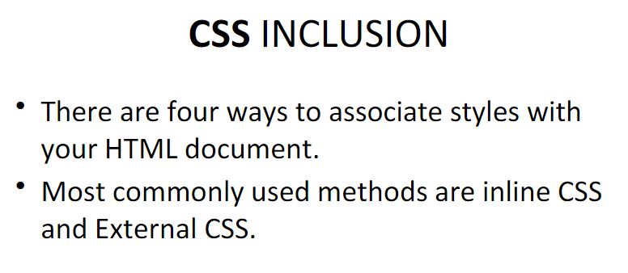
Week #3
AI Academy®
2

Slide 3
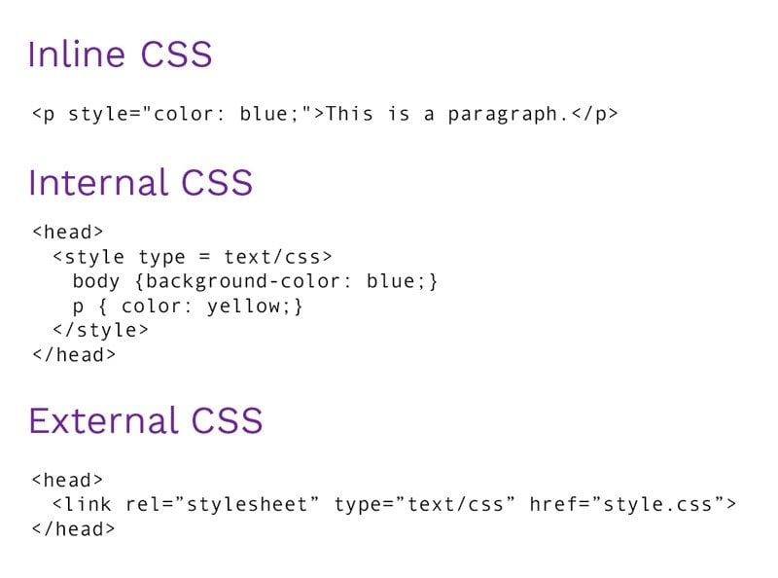
Week #3
AI Academy®
Inclusion types?
3

Slide 4
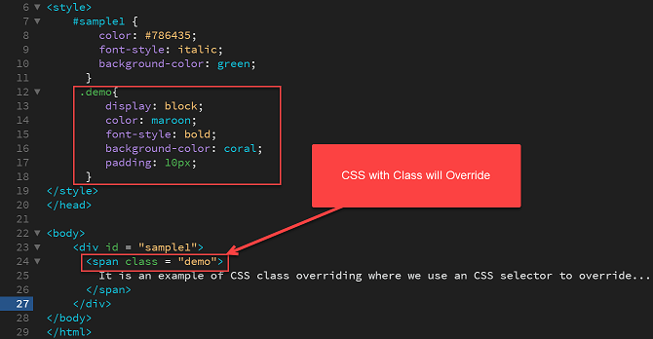
Week #3
AI Academy®
Override Rule, Colors, Background CSS example:
4

Slide 5
Week #3
AI Academy®
5
Day 2:
CSS Height/Width
CSS Padding
CSS Margins
Reviews & Feedbacks

Slide 6
Week #3
AI Academy®
CSS Height, Width, Padding and Margin Difference:
6
Height distance from the top of an object to the bottom.
Width distance from one side of an object to the other.
Padding is amount of inner space an element has.
Margin is amount of outer space an element has.

Slide 7
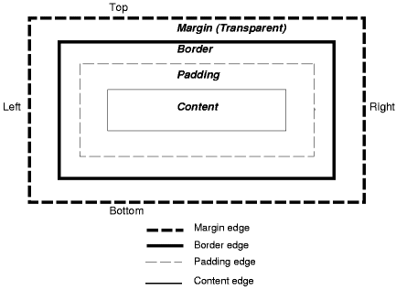
Week #3
AI Academy®
Example:
7

Slide 8
Week #3
AI Academy®
8
Day 3:
CSS Lists
CSS Tables
CSS Display
CSS Float
Reviews & Feedbacks

Slide 9
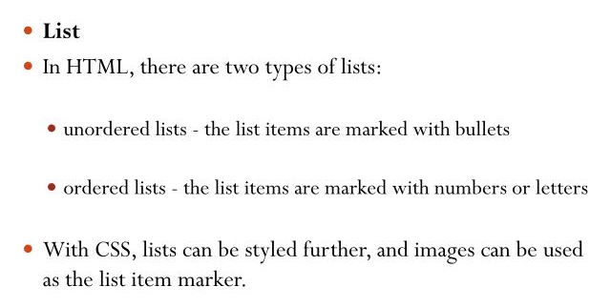
Week #3
AI Academy®
CSS : Lists
9

Slide 10
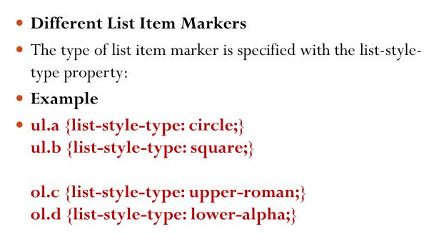
Week #3
AI Academy®
CSS : Lists
10

Slide 11
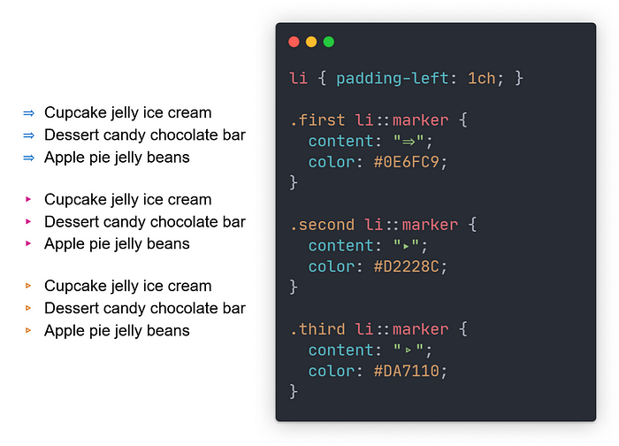
Week #3
AI Academy®
CSS Lists:
11

Slide 12
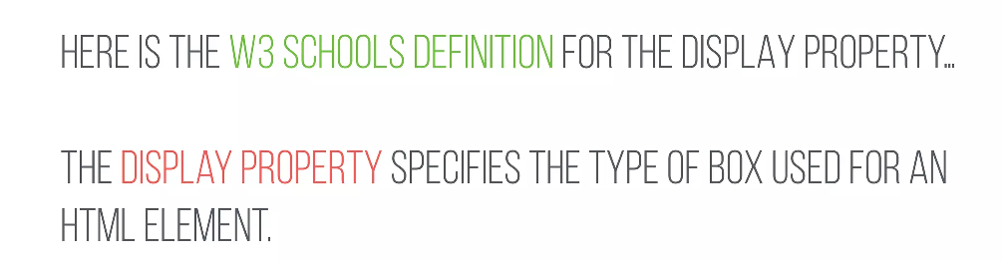
Week #3
AI Academy®
CSS Display Definition:
12

Slide 13
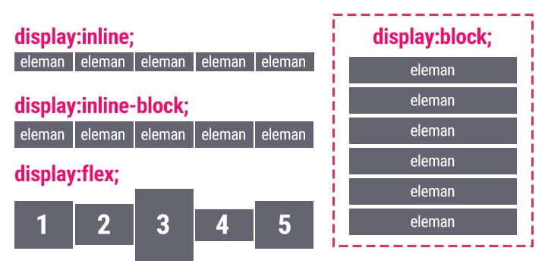
Week #3
AI Academy®
CSS Display properties:
13

Slide 14
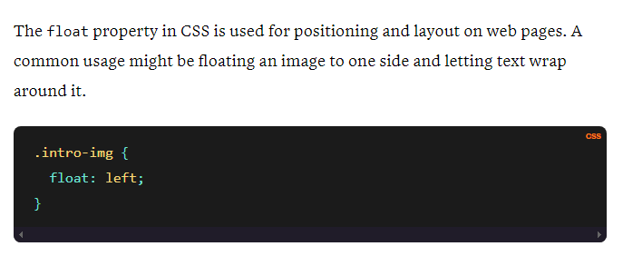
Week #3
AI Academy®
CSS Float:
14

Slide 15
Week #3
AI Academy®
15
Day 4:
What is Bootstrap?
Bootstrap Grid System
Bootstrap Colors
Bootstrap Buttons
Reviews & Feedbacks

Slide 16
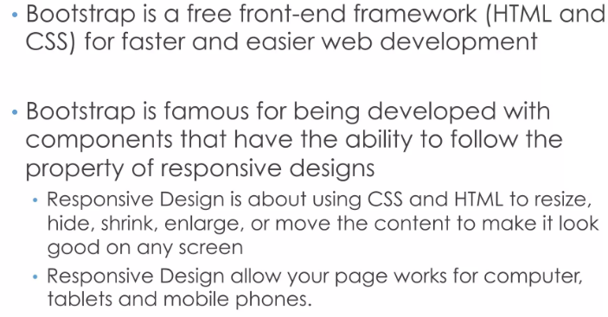
Week #3
AI Academy®
What is Bootstrap?
16

Slide 17
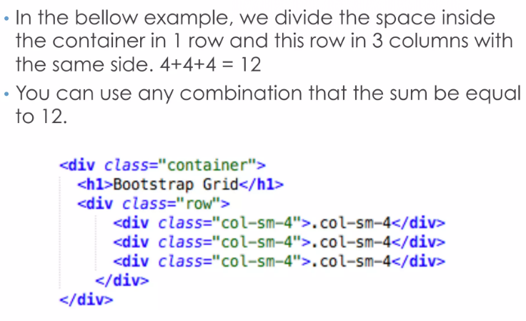
Week #3
AI Academy®
Bootstrap Grid System:
17

Slide 18
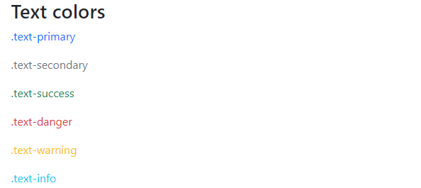
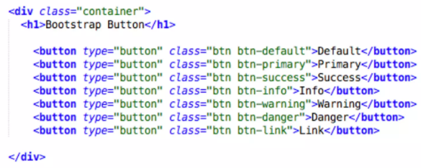

Week #3
AI Academy®
Bootstrap Colors and Buttons:
18

Slide 19
Week #3
AI Academy®
19
Day 5:
Bootstrap Navbar
Bootstrap Modal
Bootstrap Tables
Bootstrap Forms
Reviews & Feedbacks

Slide 20
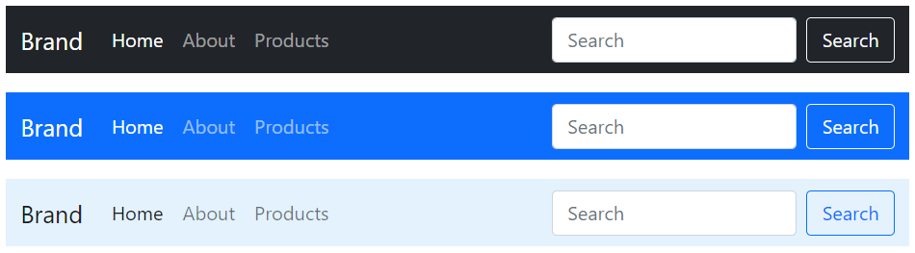
Week #3
AI Academy®
Bootstrap Navbar:
20
A set of buttons or images in a row or column that serves as a control point to link the user to sections on a website.

Slide 21
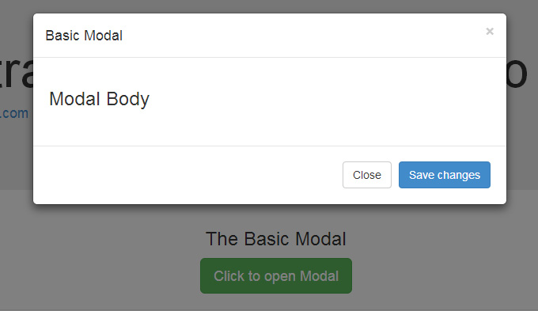
Week #3
AI Academy®
Bootstrap Modal:
20
The .modal class identifies the content of <div> as a modal and brings focus to it. The .fade class adds a transition effect which fades the modal in and out.

Slide 22
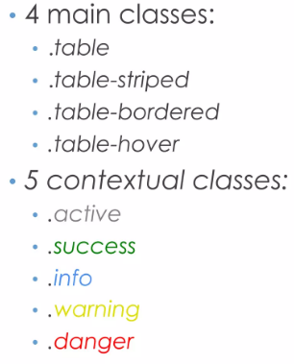
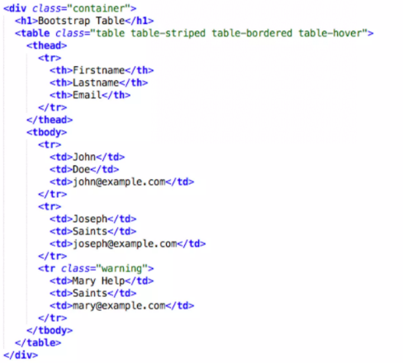
Week #3
AI Academy®
Bootstrap Tables:
21

Slide 23
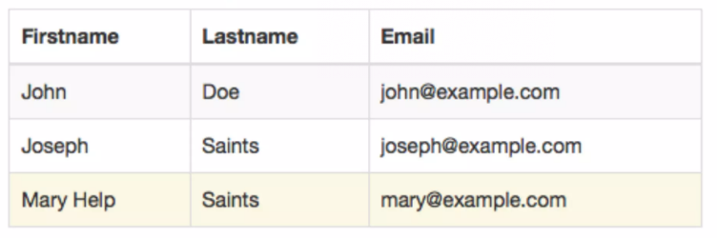
Week #3
AI Academy®
Bootstrap Table View:
22

Slide 24
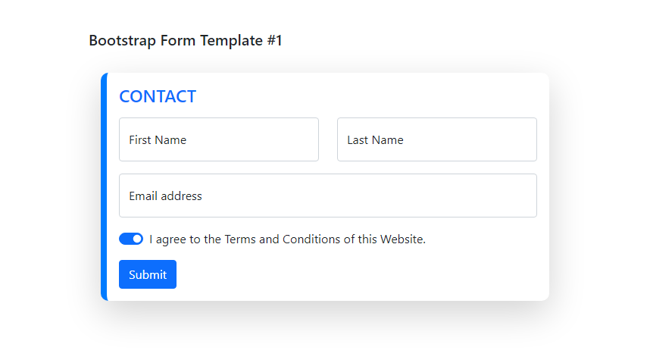
Week #3
AI Academy®
Bootstrap Forms:
23
Bootstrap forms are input-based components which are designed to collect users data.
Examples of Login, Register, Contact, more forms.

